Slide 1

A presentation on…..
Optimization of Surface Integrity in Ball End Milling of Inconel 718
By
N. N. Bhopale, Raju S. Pawade, Swapnil Harel
Department of Mechanical Engineering
Dr.Babasaheb Ambedkar Technological University, Lonere MS

Slide 2
Outline
Introduction- Inconel 718
Machining Difficulties
Experimental work
Results and discussion
Conclusions

Slide 3
Inconel 718: Superalloys
High temperature heat resisting - Precipitation hardened Ni-base superalloy - Group VIIIA elements
Complex physical metallurgy
Developed for turbo superchargers and aircraft turbine engines
Mechanical properties |  | Thermal properties
Hardness | 412HV | Thermal conductivity,WM⁻¹K⁻¹ | 15.0
Young’s modulus, GPa | 206 | Density, g cm⁻³ | 8.47
Yield strength, Mpa | 1034 | Specific heat, J Kg ⁻¹ K⁻¹ | 461
Tensile strength, Mpa | 1276 | Thermal expansion, x 10⁻⁶ K ⁻¹ | 11.5
Elongation, 50 mm% | 10-12 | Melting temperature, °K | 1550
Composition | Ni 52.2 Fe18.5 Cr 19 Mo 3.05 Nb+Ta 5.3 Ti 0.9 Al0.5 C0.04 Mn 0.2 Si 0.3 B0.005

Slide 4
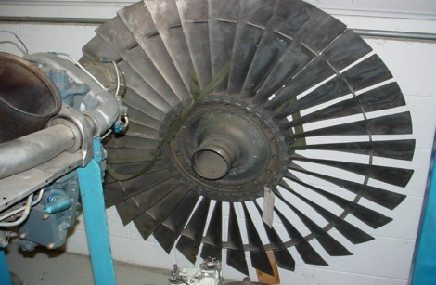
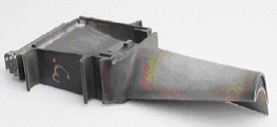
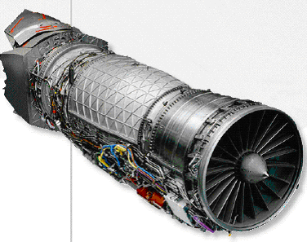
Applications of Superalloys
Turbofan
Applications | Components
Gas turbine | Blades, disks, shafts, casing, engine mounts, fasteners, wheels, buckets
Rocket motors | Exhauster, thrust reverser
Pumps | Impellers, bodies
Space shuttle | Engine parts, exhaust valves, hot plugs, turbochargers
Space station | Pressure vessels of nickel-hydrogen batteries
Cryogenics | Cryogenic tanks
Nuclear power | Nuclear fuel element spacers
Tooling | Hot extrusion tooling
Heat treatment | Equipments for heat treatments
Medical application | Dentistry uses, prosthetic devices
Turbine blade
Jet engine

Slide 5
Machining Difficulties - Inconel 718
Mechanical properties | Machining difficulties
High temperature strength | Softening of cutting tools
High shear strength | Higher cutting forces and stresses
High toughness | Tough chips causing seizure and catering of rake surface
High abrasive resistance | Excessive tool wear
Poor thermal diffusivity | High machining temperatures

Slide 6
Ball end mill
due to the rounded edge design,
Very high Toughness and durability of Cutting edge,
Handel with very high feedrate
Mill material very quickly
Produce lower cutting forces
Milling many types of material, plastic-alloys
Uses
Three dimensional countered shapes, i.e. mold and dies
Semicircular cross section groves.

Slide 7
Motivation and Objectives
To assess the effect of process related (cutting speed, feed rate, cutter path and inclination to workpiece) and the surface integrity.
To evaluate, the significance of the above input parameters on the output response variable to enhance surface integrity.
Optimization of the process parameter by evolutionary Teaching and learning based optimization (TLBO) method.

Slide 8
Experimental Setup - Actual
Ball nose end mill
Nikon measuring microscope
Workpiece with different thickness
Machined slot

Slide 9
Experimental Plan
Experimental plan
Input Parameter
Machining Parameters
Design Constraints
Cutting Speed
Feed
Workpiece thickness
Workpiece orientation
Experimental Analysis
Central Composite Design
Output parameter
Deflection of Workpiece
Surface Roughness
Microhardness
Mathematical Modeling
Deflection
Orientation
Correlation
Surface Roughness
Microhardness
Optimization of Model by using Non-conventional Optimization technique

Slide 10
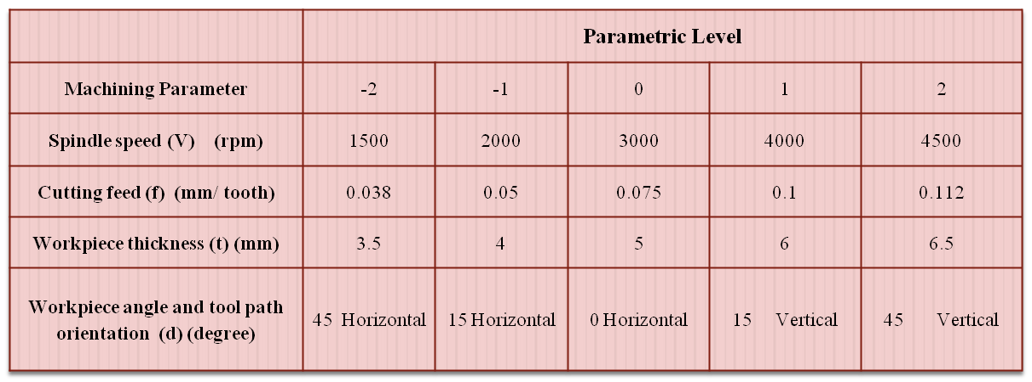
Input Factors with different levels

Slide 11
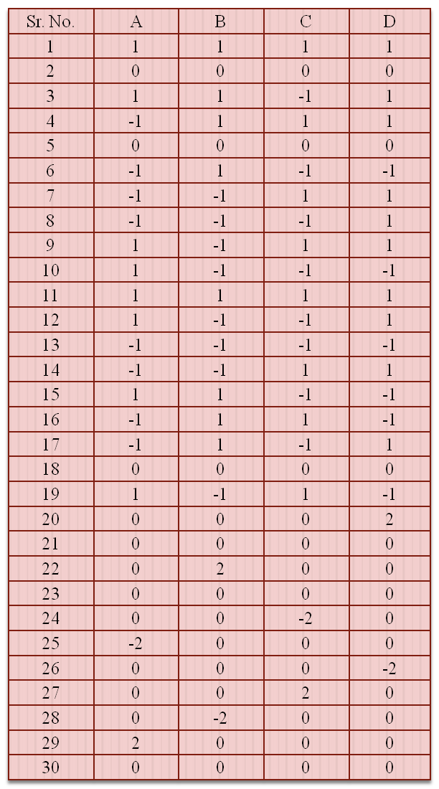
CCD Array

Slide 12
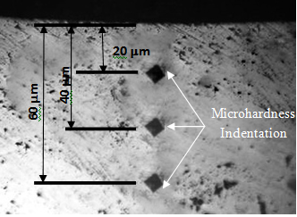
Results and discussion
Photographic view of microhardness indentation
Variation of cutting zone in different portion of cantilever with respect to deflection

Slide 13
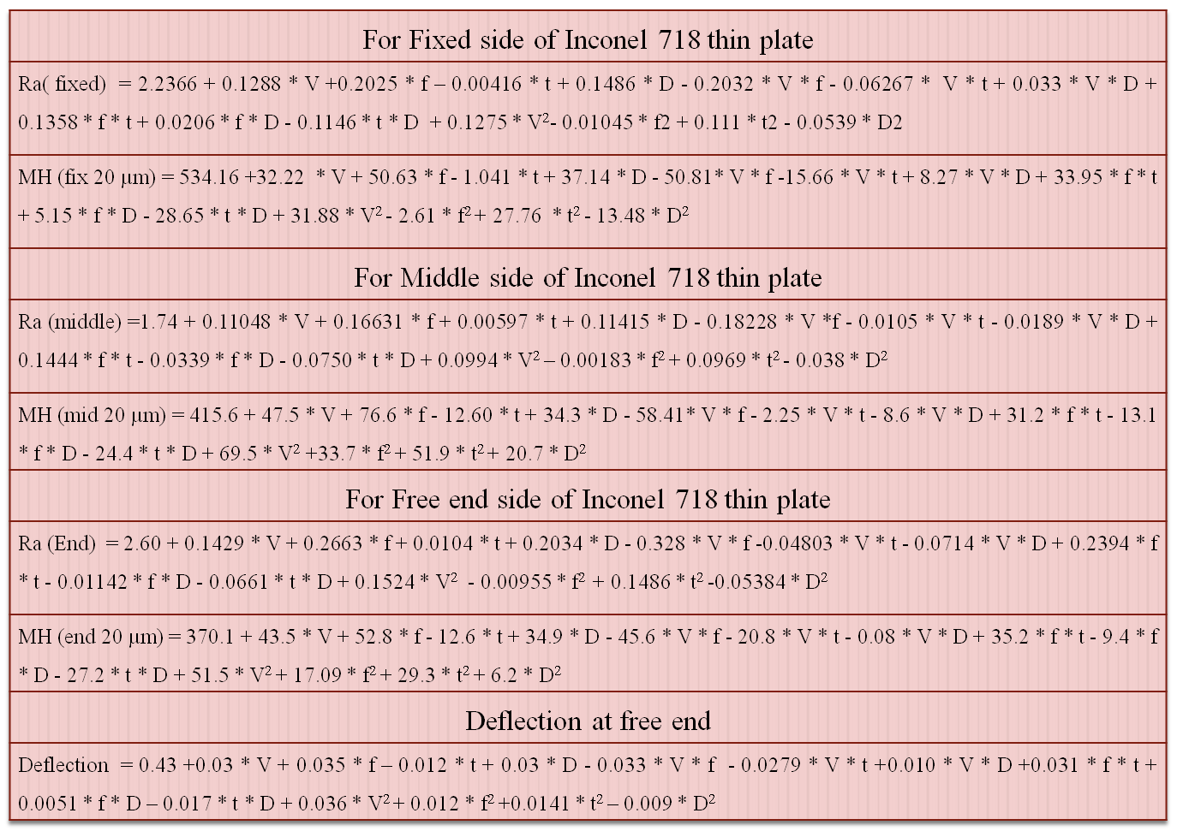
Mathematical Model

Slide 14
Table : R² and adjusted R² values
Response | R² | Adjusted R²
Ra at fixed | 91.00 | 83.00
MH (fix 20 µm) | 91.63 | 86.00
Ra at mid | 92.20 | 84.23
MH (mid 20 µm) | 89.64 | 78.24
Ra at end | 92.07 | 90.23
MH (end 20 µm) | 80.23 | 79.20
Deflection | 91.00 | 84.76
Table : Input factors for the confirmation test
Parameter | Level 1 | Level 2
Spindle speed (rpm) | 2000 | 4000
Feed (mm/ tooth) | 0.05 | 0.1
Plate thickness (mm) | 4 | 7
Workpiece path and cutter orientation (degree) | 15° Horizontal | 15° Vertical

Slide 15
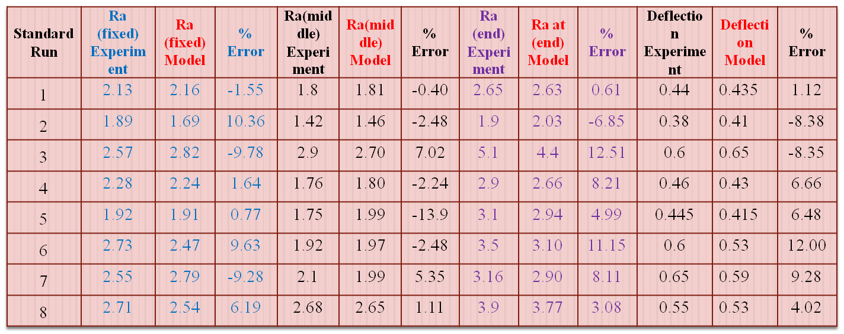
Validation of Model
Verification of model for surface roughness and deflection

Slide 16
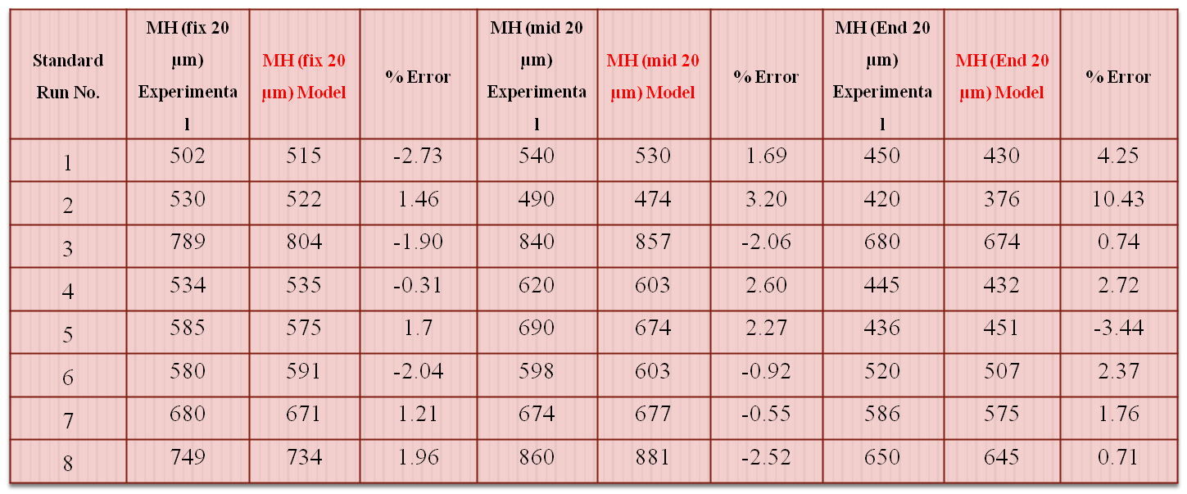
Contd.
Verification of models for Microhardness

Slide 17
Optimization of Model
Initialize the population, design variables and termination criterion
Evaluate the initial population
Keep the elite solutions
Teaching and learning based optimization technique.
TLBO is a teaching-learning process inspired algorithm proposed by Rao et al.
Through teacher (known as teacher phase) and
interacting with the other learners (known as learner phase).
Calculate the mean of each design variable
Select the best solution
Calculate the Difference_Mean and modify the solutions based on best solution
Is new solution
better than existing?
Keep the
Previous solution
No
Yes
Acceptt
Select the solutions randomly and
Modify them by comparing with each other
Is new solution
better than existing?
Keep the
Previous solution
No
Yes
Accept
Replace worst solutions with elite solutions
Modify duplicate solutions
Is termination
criterion fulfilled?
No
Final value of solution
Flowchart of elitist TLBO algorithm

Slide 18
Optimization of surface roughness
Objectives | Ra at fixed side of thin inconel 718 plate represented by eq.
 | Ra at middle side of thin inconel 718 plate represented by eq.
 | Ra at free end side of thin inconel 718 plate represented by eq.
Subject to models | MH at fixed side at 20 µm < 500 eq.
 | MH at middle side at 20 µm < 500 eq.
 | MH at free end side at 20 µm < 500 eq.
 | 0.1 < Deflection at free end < 0.5 eq.
Optimization of Microhardness
Objectives | Minimization of MH at fixed side at 20 µm eq.
 | Minimization of MH at middle side at 20 µm eq.
 | Minimization of MH at free end side at 20 µm 500 eq.
Subject to models | Ra at fixed side eq.
 | Ra at middle side eq.
 | Ra at free end side eq. no.
 | 0.1 < Deflection at free end < 0.5 eq.
Range for input parameters are fixed as follow,
-1 < V (rpm) < +1, -1 < f (mm/tooth) < +1, -1 < t (mm) < +1 and -1 < D (degree) < +1.

Slide 19
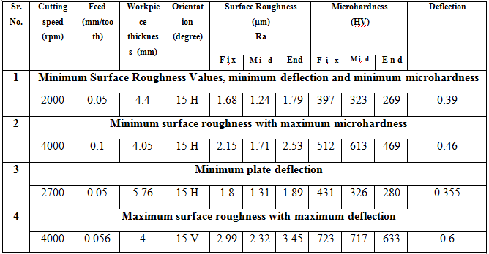
Suggested Optimized solutions at different condition

Slide 20
Conclusions
Response surface methodology, mathematical models are prepared for surface integrity, which is having significant R –square values more than 90%, which are further validated using Taguchi L8 orthogonal array showing less than 10 % error from the actual values.
Teaching learning based optimization agreed quite well in optimization of machining parameters of ball end milling process and give better solutions as compared to other approaches.
TLBO gives solution at various output condition by setting different constrains. TLBO also finds some new values of control factors.

Slide 21
Thank you….

Slide 22
References
Yildiz A. R, "A Comparative Study of Population Based Optimization Algorithms for Turning Operation"InfSci, pp. 81-80, 2012.
Chen MC, Tsai DM,"A Simulated Annealing Approach for Optimization of Multipass Turning Operation"International Journal of Production Reasearch 34, pp. 2803-2825, 1996.
A. Arun, Premnath Alwarsamy T, and Raymohan T, "Experimental Investigation and Optimization of Process Parameter in Milling of Hybrid Metak Matrix Composit",Materials and Manufacturing Process27, pp. 1035-1044, 2012.
Raju S. Pawade, and Joshi S."Multi-objective Optimization of Surface Roughness and Cuttingforces in High-speed turning of Inconel 718 using Taguchi Gray Relation Method."International Journal of Advance Manufacturing Technology, 2011.
Mark Evans,"Optimisation of Manufacturing Process, AResponse Surface Approach" Maney, 2003.
Hou, J. Z, W Zhou, and N Zhao,"Effect of Cutting Parameters on Ignition of AM50A of Alloy during Face Milling"Materials and Manfacturing Process10, no. 251, pp. 1048-1051, 2010.
Bouzakis K. D, P Aichouh and Efstatiouk,"Determination of the Chip Geometry, Cutting Forces and Roughness In Free Form Surface Finishing Milling with Ball End Tools"International Journal of Machine Tool Manufacturing 43, pp. 499-514,2003.
Sonawane, H, Joshi Suhas, N Bhopale, and Raju Pawade"Analysis and modelling of cutting forces in ball end milling of superalloysInconel 718", 26th national convention of Mechanical Engineering, 2010.
9. Togan. V,"Design of planer steel frames using teaching-learning based optimization" Engineering structure, 34, pp. 225-232, 2012.
10. Rao R. V, V. J Savasani, and Vakharia D. P."Teaching-learning based optimization: a novel method for constrained mechanical design
optimization problems"Computer-Aided Design 43, no. 3, pp. 303-315, 2011.
11. Rao R. V, and Kalyankar VD,"Parameter optimization of adv. machining process using TLBO algorithm"EEPM, Singapore, pp. 20 -21,
2011.
12. Rao.R. V, V. J Savasni, and D. P. Vakharia,“Teaching- Learning based optimization; an optimization method for continuous non-linear
large scale problems"Inf Sci 1, no. 183 pp.1-15, 2012.
13. Bhopale N.N. and Pawade R. S.“Investigation of surface integrity in high-speed ball end milling of cantilever shaped thin plate of
Inconel 718”Journal of Achievements in Materials and Manufacturing Engineering 55/2 pp.616-622, 2012.

